Slide 1
CSC 323 – Principles of Operating Systems
Instructor: Ms. Mamoona Tasadduq
Topic: Threads

Slide 2
Processes
Recall that a process includes many things
  An address space (code, data),
  OS resources (e.g., open files) and accounting information
  Execution state (program counter, registers, and stack pointer etc.).
Creating a new process is costly
  because of all of the data structures that must be allocated and initialized
Communicating between processes is also costly
  because most communication goes through the OS
    overhead of system calls and copying data

Slide 3
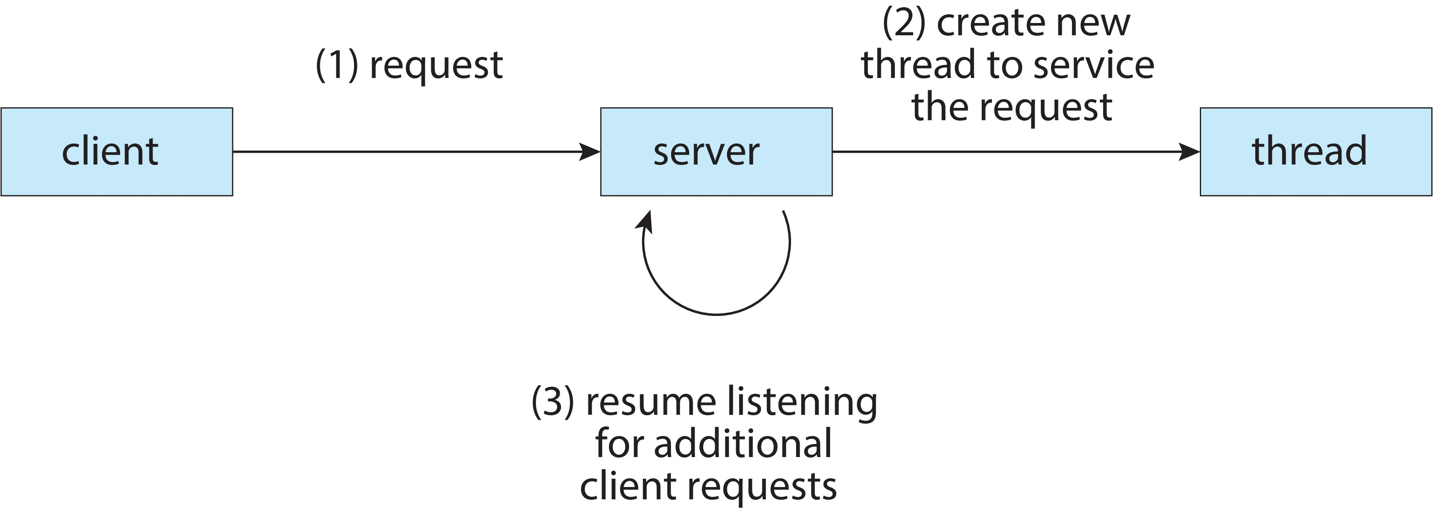
Example: Web Server
How does a web server handle a request?
A web server needs to handle many concurrent requests.
Solution 1:
  forks off copies of itself to handle multiple simultaneous requests
  Processes communicate with each other via inter-process communication

Slide 4
Concurrent Programs
To execute these programs, we need to
  Create several processes that execute in parallel
  Cause each to map to the same address space to share data
    They are all part of the same computation
  Have the OS schedule these processes in parallel (logically or physically)
This situation is very inefficient
  Space: PCB, page tables, etc.
  Time: create data structures, fork and copy address space, etc.

Slide 5
Rethinking Processes
What is similar in these cooperating processes?
  They all share the same code and data (address space)
  They all share the same privileges
  They all share the same resources (files, communication channels, etc.)
What don’t they share?
  Each has its own execution state: PC, SP, and registers
Idea: Why not separate the process concept from its execution state?
  Process: address space, privileges, resources, etc.
  Execution state: PC, SP, registers
Execution state also called thread of control, or thread

Slide 6
Threads
Modern OSes separate the concepts of processes and threads
  The thread defines a single sequential execution stream within a process
  The process defines an address space and general process attributes
A thread is bound to a single process
  Processes, however, can have multiple threads
Threads become the unit of scheduling
  Processes are now the containers in which threads execute
  Processes become static, threads are the dynamics entities
Data structure: Thread Control Block (TCB)

Slide 7
Process Control Block (PCB)
Process management information
  Process state (running, ready, waiting)
  PC & CPU registers, parents, etc.
  CPU scheduling information (priorities, etc.)
Memory-management information
  memory allocated to the process (segments, page tables etc.)
I/O and file management
  Communication ports, directories, file descriptors etc.

Slide 8
Thread Control Block (TCB)
Shared information
  Process info: parent process
  Memory: code/data segment, page table, and stats
  I/O and file: communication ports, open file descriptors
Private information
  State (ready, running and waiting)
  Registers, Program counter
  Execution stack

Slide 9
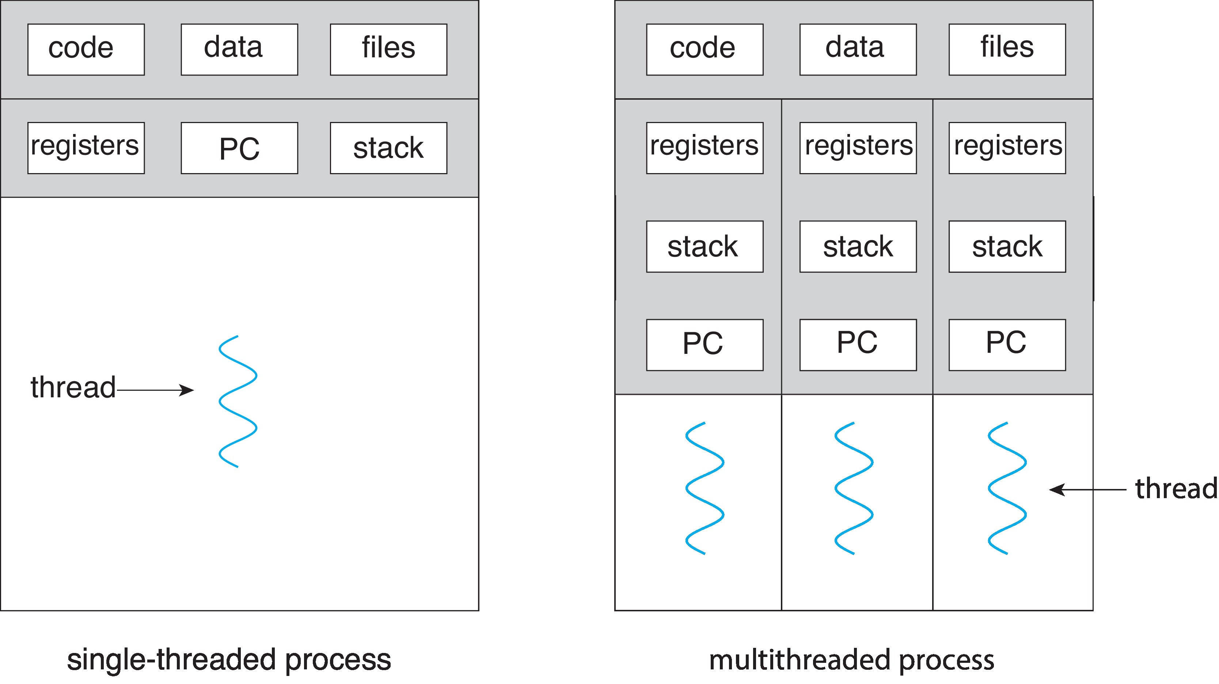
Threads in a Process
What about heap?

Slide 10
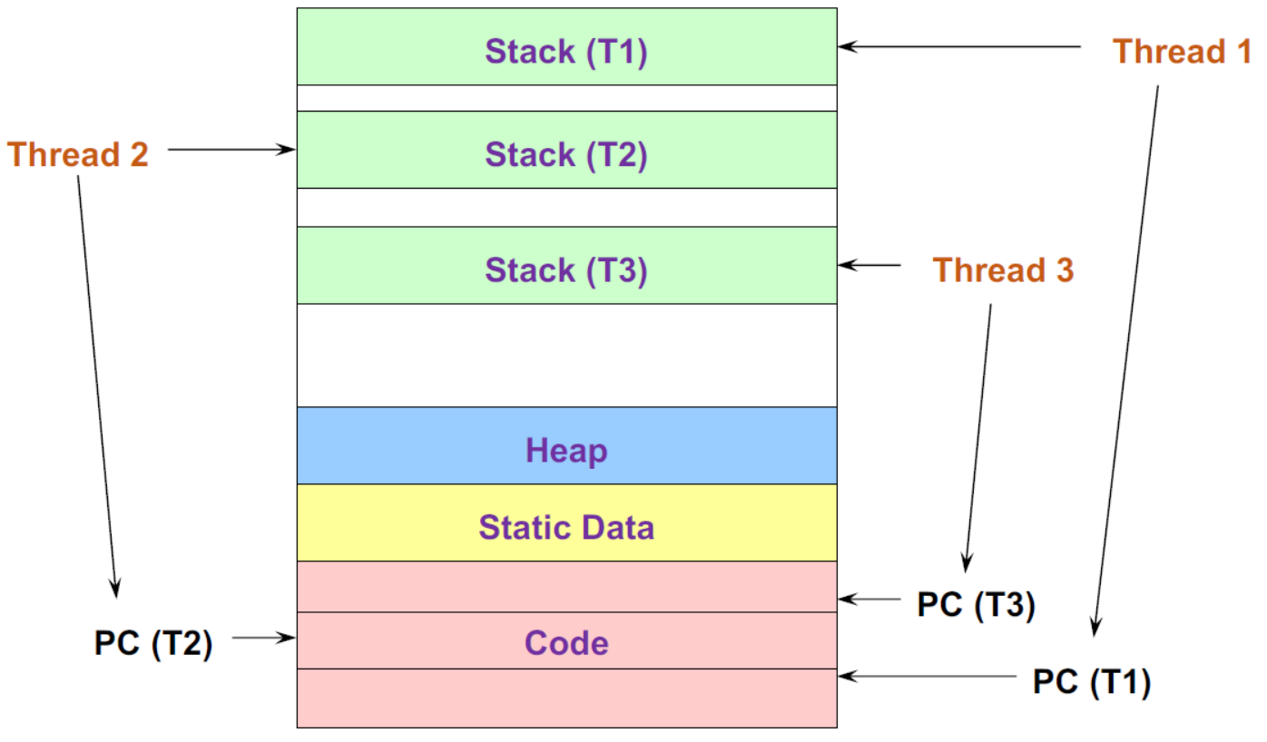
Threads in a Process

Slide 11
Threads vs. Processes
Process | Thread
Processes are containers in which threads execute. | Threads are the unit of scheduling.
Each process executes the same code but has its own address space and file resources. | Thread can share same set of open files and child processes. There can be several threads in a single address space.
Each process operates independently of the others. | A thread can access and alter another thread's data.
Process switching needs interaction with the operating system to save the states of address space, resources, accounting info. etc., along with PC, SP, and registers, therefore, it is slower. | Thread switching doesn’t need interaction with the operating system as only the states of the PC, SP, and registers are saved, therefore, it is faster.
If a process is blocked by some I/O request, then no further execution is possible until it gets unblocked. | If a thread is blocked by some I/O request, another thread in the same task can continue its execution.
Process is heavyweight or resource intensive. | Thread, also known as “lightweight” process takes lesser resources than a process.

Slide 12
Process/Thread Separation
Easier to support multithreaded applications
  Concurrency does not require creating new processes
Concurrency (multithreading) can be very useful
  Improving program structure
  Allowing one process to use multiple CPUs/cores
  Handling concurrent events (e.g., Web requests)
  Allowing program to overlap I/O and computation
So multithreading is even useful on a uniprocessor
  Although today even cell phones are multicore
But brings a whole new meaning to Spaghetti Code
  Forcing OS students to learn about synchronization

Slide 13
Multicore Programming
Multicore or multiprocessor systems putting pressure on programmers, challenges include:
  Dividing activities
  Balance
  Data splitting
  Data dependency
  Testing and debugging
Parallelism implies a system can perform more than one task simultaneously
Concurrency supports more than one task making progress
  Single processor / core, scheduler providing concurrency

Slide 14
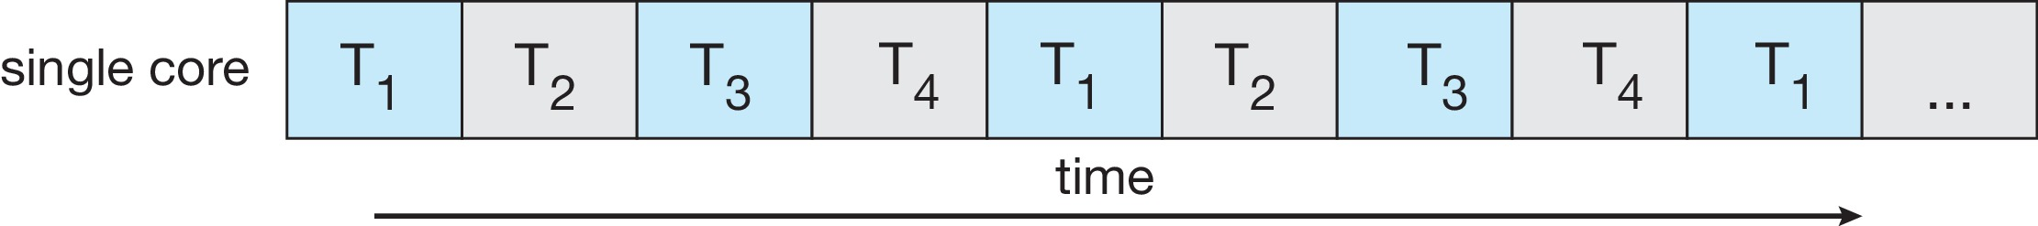
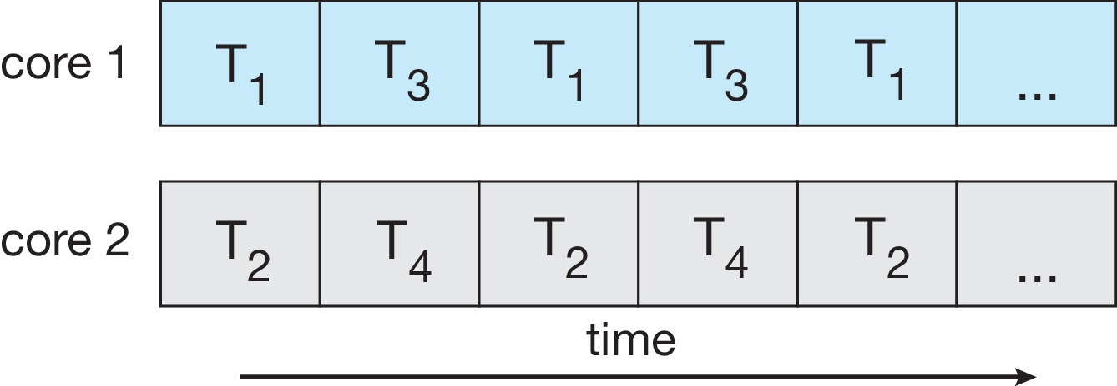
Concurrency vs. Parallelism
Concurrent execution on single-core system:
Parallelism on a multi-core system:

Slide 15
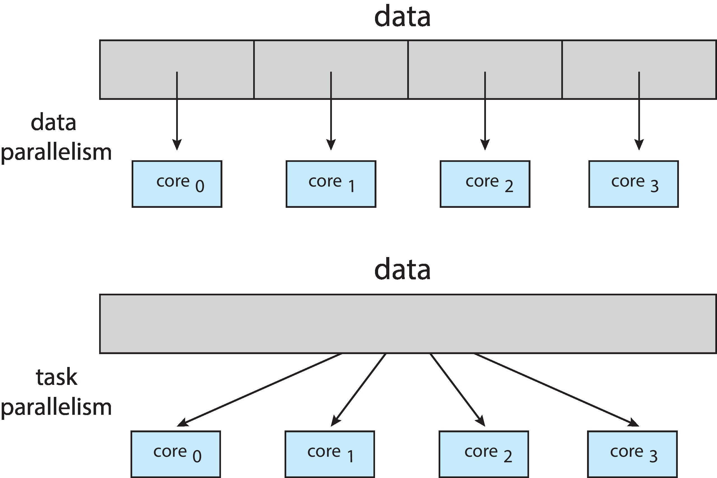
Multicore Programming
Types of parallelism
  Data parallelism – distributes subsets of the same data across multiple cores, same operation on each
  Task parallelism – distributing threads across cores, each thread performing unique operation
As number of threads grows, so does architectural support for threading
  CPUs have cores as well as hardware threads
  Consider Oracle SPARC T4 with 8 cores, and 8 hardware threads per core

Slide 16
Motivation
Most modern applications are multithreaded
Threads run within application
Multiple tasks with the application can be implemented by separate threads
Update display
Fetch data
Spell checking
Answer a network request
Process creation is heavy-weight while thread creation is light-weight
Can simplify code, increase efficiency
Kernels are generally multithreaded

Slide 17
Benefits of Threads
Responsiveness – may allow continued execution if part of process is blocked, especially important for user interfaces.
  E.g., user interaction and image loading in multi-threaded web browser:
Resource Sharing – threads share resources of process, easier than shared memory or message passing
Economy – cheaper than process creation, thread switching lower overhead than context switching
  Solaris: creating process is thirty times slower
  Context-switch is about five times slower
Scalability – process can take advantage of multiprocessor architectures

Slide 18
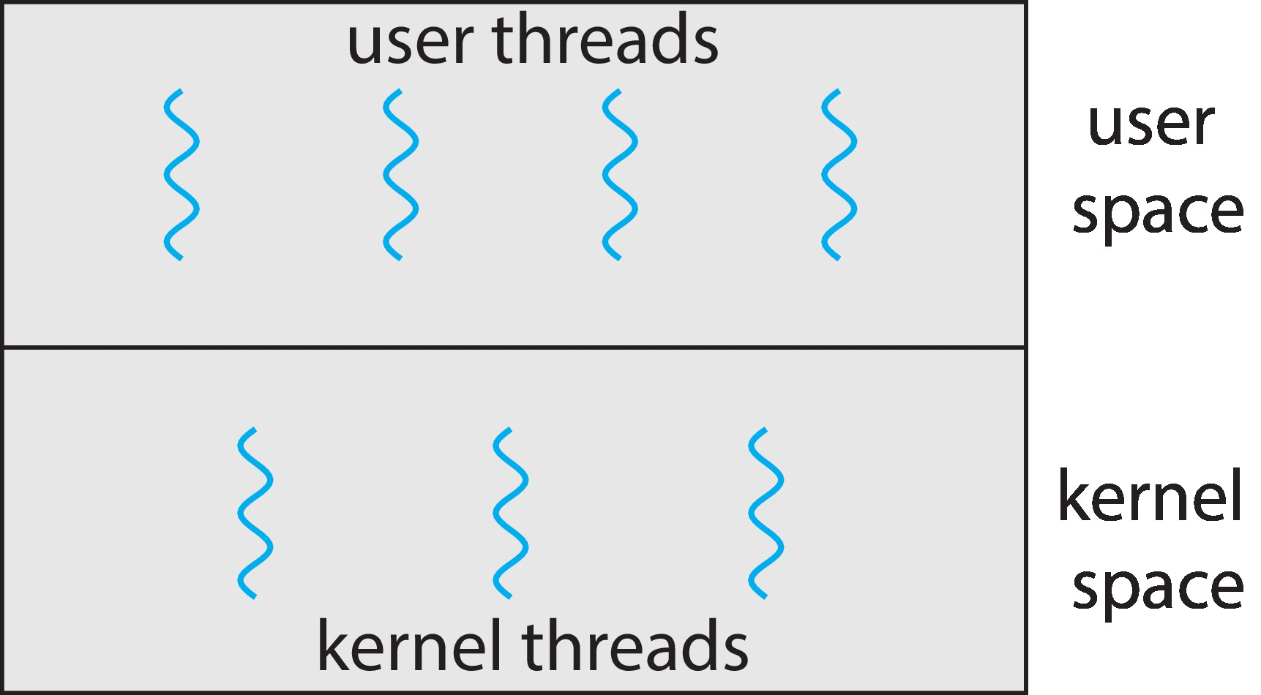
Kernel-Level Threads
All thread operations are implemented in the kernel
The OS schedules all the threads in the system
A blocking system call will not block the whole process
Examples:
  Windows
  Solaris
  Linux
  Tru64 UNIX
  Mac OS X

Slide 19
Kernel-Level Threads
Entry Point and Preemption:
The entry point refers to the starting function of a thread, usually the first thread launched by a program (often the main thread).
During execution, if a thread is preempted (meaning the OS temporarily interrupts its execution), the kernel performs a context switch. This involves saving the current thread’s state (such as the program counter, registers, etc.) so that it can resume from the same point later.
The kernel then switches to another thread, which starts executing.
Once the second thread finishes its execution or is preempted, the kernel can restore the state of the original thread, allowing it to continue from where it left off.

Slide 20
Kernel-Level Threads
Pros
True Parallelism: Since the kernel can independently schedule threads on different processors (on a multi-core system), kernel-level threads allow for true parallel execution.
Better Resource Utilization: The kernel can optimize system resource allocation (like CPU time) across all threads, ensuring efficient multitasking.
Cons
Higher Overhead: The kernel has to perform frequent context switches between threads, which adds overhead compared to user-level threading. Each switch requires saving and restoring thread states, which can be resource-intensive.

Slide 21
Kernel Thread Limitations
Every thread operation must go through kernel
  create, join, exit, synchronize, or switch for any reason
  Generally: threads 10x to 30x slower when implemented in kernel
One-size fits all thread implementation
  Kernel threads must please all people
  Maybe pay for fancy features (priority etc.) you don’t need
General heavy-weight memory requirements
  e.g., requires a fixed-size stack within kernel
  other data structures designed for heavier-weight processes

Slide 22
Alternative: User-Level (Artificial) Threads
Implement as user-level library
  One kernel thread per process
  thread_create, thread_exit, etc., just library functions
  Library does thread context switch
Usually faster to create and manage
Examples:
  POSIX Pthreads,
  Java threads

Slide 23
User-Level Thread
No Kernel Involvement: The kernel does not manage the switching between threads. Instead, the application itself (using a threading library) manages when and how threads switch. This means that switching between threads (context switching) is much faster because it doesn't require the overhead of asking the operating system for permission.
Switching: If one thread finishes its task or reaches a point where it should yield (pause), the thread library in user space will decide which other thread to run next. The kernel doesn’t step in for this; it's all handled within the application as programmed by the programmer.

Slide 24
User-Level Thread Limitations
Cannot take advantage of multiple CPUs or cores
User-level threads are invisible to the OS
  They are not well integrated with the OS
As a result, OS can make poor decisions
  Scheduling a process with idle threads
  A blocking system call (e.g., disk read) blocks all threads
    Even if the process has other threads that can execute
  Unscheduling a process with a thread holding a lock
How to solve this?
  Communication between the kernel and the user-level thread manager (Windows 8)
    Scheduler Activation

Slide 25
Efficient Use of Artificial Threading
Artificial threading can make throughput great if used efficiently.
Despite blocking issues, user-level threads can improve performance if used correctly. This happens because switching between threads is faster (as it avoids kernel intervention). An example would be using global variables to share data between threads, reducing overhead.

Slide 26
Kernel vs. User Threads
Kernel-level threads
  Integrated with OS (informed scheduling)
  Slower to create, manipulate, synchronize
User-level threads
  Faster to create, manipulate, synchronize
  Not integrated with OS (uninformed scheduling)
Understanding their differences is important
  Correctness, performance
Or use both kernel and user-level threads
  Can associate a user-level thread with a kernel-level thread
  Or multiplex user-level threads on top of kernel-level threads

Slide 27
Multithreading Models
Three common ways to establishing a relation between user and kernel threads are as follow:
  Many-to-One
  One-to-One
  Many-to-Many
In user thread implementation, all user threads of the same process are effectively mapped to one kernel thread

Slide 28
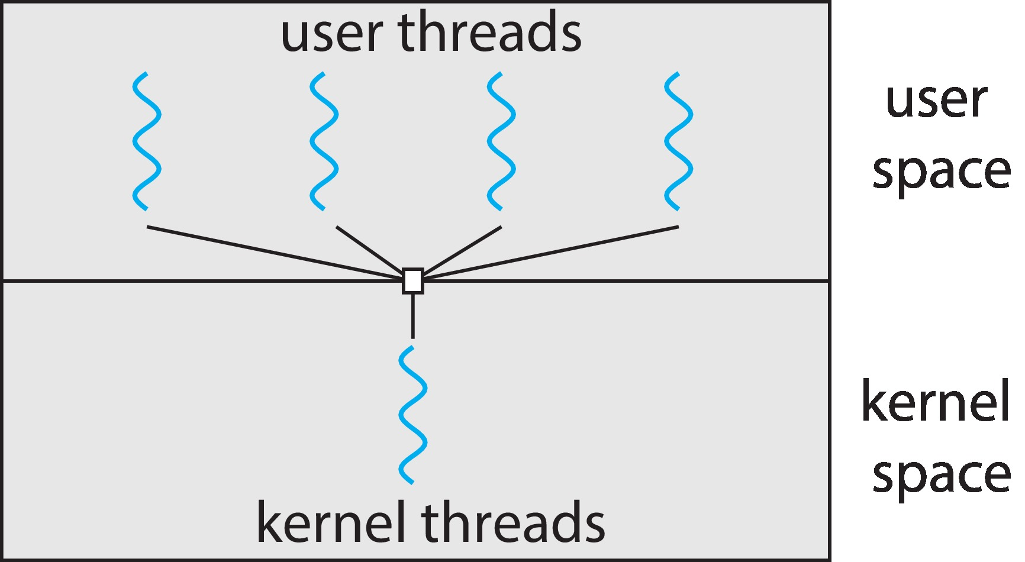
Many-to-One
Many user-level threads mapped to single kernel thread
One thread blocking causes all to block
Thread management is done by a thread library in user space
Multiple threads may not run in parallel on multi-core system because only one may be in kernel at a time
Few systems currently use this model
Examples:
  Solaris Green Threads
  GNU Portable Threads

Slide 29
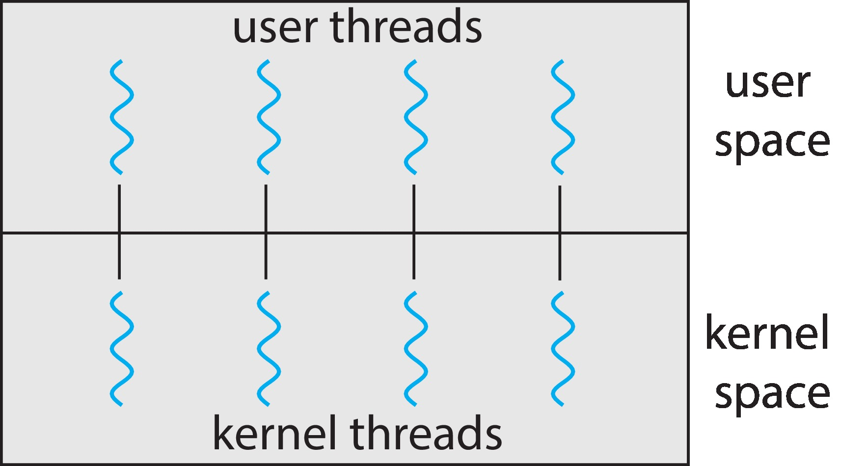
One-to-One
Each user-level thread maps to a kernel thread
Creating a user-level thread creates a kernel thread
More concurrency than many-to-one model
System keeps running while one thread executes a blocking system call
It also allow multiple threads to run in parallel on multiprocessor system
Number of threads per process sometimes restricted due to overhead
May lead to too many kernel threads
Examples:
  Windows
  Linux

Slide 30
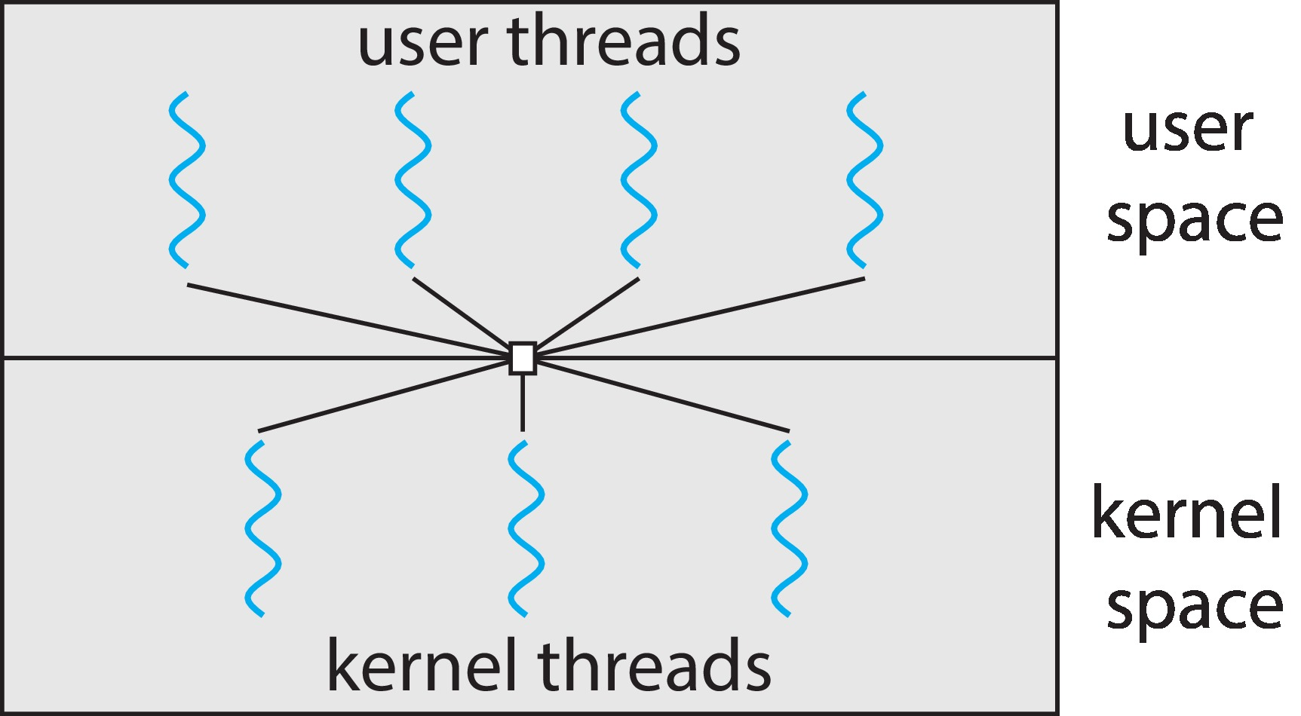
Many-to-Many
Allows many user level threads to be mapped to many kernel threads
Allows the operating system to create a sufficient number of kernel threads
Examples:
  Windows ThreadFiber package
  Otherwise not very common

Slide 31
Thread Context Switch
The context switch routine does all of the magic
  Saves context of the currently running thread
    Push all machine state onto its stack
  Restore context of the next thread
    Pop all machine state from the next thread’s stack
  The next thread becomes the current thread
  Returns to caller as new thread
This is all done in assembly language
  It works at the level of the procedure calling convention, so it cannot be implemented using procedure calls

Slide 32
Context Switching of User-Level Threads
If both threads belong to the same process
  Handled by the dispatcher in the library
    Only need to store/load the TCB information
  OS does not do anything
If both threads belong to different processes
  Like an ordinary context switch of two processes
    Handled by OS (drop in/out of the kernel)
    OS needs to load/store PCB and TCB information

Slide 33
Programming with Threads: Thread Libraries
Thread library provides programmer with API for creating & managing threads
Two primary ways of implementing
  Library entirely in user space
  Kernel-level library supported by the OS

Slide 34
Programming with Threads: Pthreads
#include <stdio.h>
#include <pthread.h>
// Function for thread 1
void* threadFunc1(void* arg) {
printf("Hello from Thread 1!\n");
return NULL;
}
// Function for thread 2
void* threadFunc2(void* arg) {
printf("Hello from Thread 2!\n");
return NULL;
}
int main() {
pthread_t t1, t2; // Thread identifiers
// Create two threads
pthread_create(&t1, NULL, threadFunc1, NULL);
pthread_create(&t2, NULL, threadFunc2, NULL);
// Wait for both threads to finish
pthread_join(t1, NULL);
pthread_join(t2, NULL);
printf("Hello from the main thread!\n");
return 0;
}

Slide 35
Programming with Threads: Pthreads
May be provided either as user-level or kernel-level
A POSIX standard (IEEE 1003.1c) API for thread creation and synchronization
Specification, not implementation
API specifies behavior of the thread library, implementation is up to development of the library
Common in UNIX operating systems (Solaris, Linux, Mac OS X)

